Slide 1

Welcome to Year 2
Emerald Class
Teacher:
Mrs Brown
Teaching Assistants:
Mrs Pattison and Miss Ahmed

Slide 2

First days in Year 2
Creating a Positive Start in Year 2
It is incredibly important that your child feels safe, happy, and supported in Year 2. Over these first few weeks, we’ve focused on building strong, positive relationships with each child to help them settle in and feel confident in their learning environment.
Early Primary education should be a joyful experience. These formative years play a vital role in shaping children’s attitudes toward learning, and we aim to foster curiosity, enthusiasm, and a love of discovery every day.

Slide 3

Curriculum
Each half term, we will send out a Curriculum Newsletter detailing what the children are going to be learning.

Slide 4
Each day, pupils will take part in core lessons including Phonics, English, and Maths. Across the week, they will also enjoy a broad and balanced curriculum with lessons in:​
Religious Education (RE)​
Science​
Computing​
Design Technology (DT) or Art​
Geography or History​
Music​
Physical Education (PE)​
Personal, Social, Health and Economic Education (PSHE)​

Slide 5

Phonics
At the start of this academic year, we’ve been revisiting all Phase 5 phonics content that children will have encountered in Year 1. This ensures a strong foundation and helps us identify any areas that may need further reinforcement. We follow the Little Wandle Letters and Sounds Revised scheme at St Mary’s, which provides a consistent and systematic approach to phonics teaching across the school.
After the autumn half term, we will transition into more focused spelling lessons, building on the phonics knowledge the children have consolidated. For children who did not pass the Year 1 Phonics Screening Check, we are providing additional targeted support to address any gaps. These children will retake the National Phonics Screening Check at the end of Year 2.

Slide 6

Reading
Reading is a vital part of learning across all areas of the curriculum.
In Year 2, we aim to listen to your child read at least three times a week during our dedicated group reading sessions. These lessons help us develop fluency, comprehension, and confidence in a supportive environment. Beyond these sessions, we weave reading opportunities throughout each school day — whether it’s exploring texts in other subjects, enjoying stories together, or practising key skills in short bursts.
Because reading is so important, we ask that you continue to read with your child at home as often as possible — ideally every day. This can be a mix of your child reading their school books to you, and you sharing books from home together. Whether it’s a bedtime story, a comic, or a favourite picture book, every moment spent reading helps build a lifelong love of learning.

Slide 7
Reading books
A new reading book will be sent home every Thursday. Your child will be familiar with the text as they will have already read it three times in school.
Parents / Carers need to write a comment in the reading record book. If there are words your child has struggled with it is useful to include these in your comments. Children DO NOT have to read their whole book every day; 5 – 10 minutes is perfect.
Please ensure your child returns their reading books every Thursday with comments written in their reading record. Please keep books and your child's reading record in your child's folder.

Slide 8
Spelling
Each week children will be given weekly spellings that will build on the phonics work we have been completing in class.
The children will get the opportunity to practice these at school but should also spend time practising them each week at home.
Children will be tested on their spellings each Friday.
If you would like any support with helping your child with learning their spellings, then please get in touch.

Slide 9
Maths
Supporting Your Child’s Maths Learning at Home
Building strong mathematical foundations in Key Stage 1 is essential for helping children become confident and capable mathematicians throughout their school journey.
A solid understanding of number is especially important at this stage. Here are some simple but effective ways you can support your child’s learning at home:
Count together during everyday activities – Count steps as you walk, the number of red cars you see on the way home, or items while shopping. These small moments help build number fluency.
Practice times tables – By the end of Year 2, children are expected to recall their 2, 5, and 10 times tables. Singing songs, using flashcards, or playing online games can make this fun and engaging.
Spot numbers in the environment – Encourage your child to read numbers on doors, clocks, signs, or packaging. This helps them become more familiar with number recognition.
Write two-digit numbers – Give your child opportunities to write numbers, especially two-digit ones. This helps them understand place value and ensures they form digits correctly in the tens and ones places.
Your support at home makes a big difference. Thank you for being a vital part of your child’s learning journey!

Slide 10
Supporting your child
Supporting Your Child’s Learning Journey in Year 2. In Year 2, children continue to develop essential skills and understanding that lay the foundations for future learning. It’s a year of growing independence, curiosity, and confidence across all areas of the curriculum.
As their primary carers and educators, your encouragement plays a vital role. Fostering a love of learning and a positive attitude towards school life at home can make a profound difference to your child’s academic progress and overall wellbeing.

Slide 11

P.E. Days
Our PE Days are Tuesday and Friday. On these days, all pupils should come to school in their PE Kits. They should not be wearing any jewellery on these days.
P.E. Kit
Black shorts or jogging bottoms / leggings
A white t-shirt
Trainers
Children should wear their school jumper or cardigan during the day but can bring a navy or black hoody to wear for P.E.

Slide 12


Slide 13

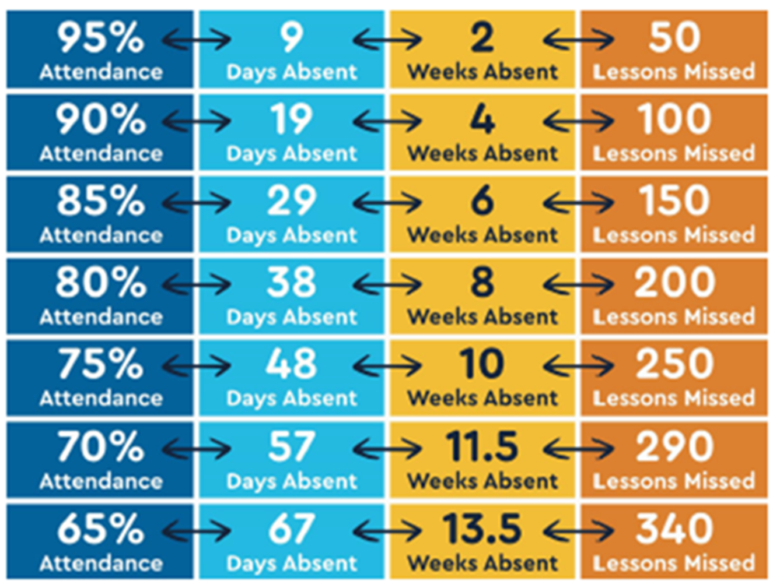

Slide 14
Children whose attendance is below 90% are classed as a persistent absentee.
Although 90% sounds quite high, in reality this is 4 weeks of learning missed … that is a lot!

Slide 15
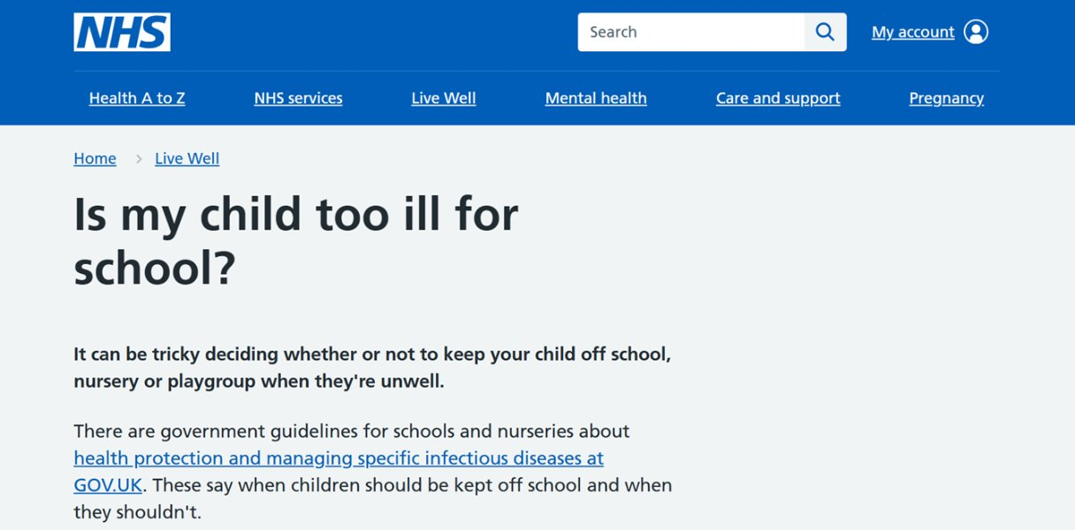
How can I let school know that my child is ill?
Send a message via Arbor
Call the school office and leave a voicemail 0113 2717204
If your child does not arrive at school then we will try to phone you and may do a home visit if we cannot contact you.

Slide 16

If you have any questions or concerns, please don’t hesitate to email me. Do note that I won’t be able to check emails during the school day as I’ll be leading learning activities. Occasionally, evening commitments or training may also delay my response, but I will always aim to reply as promptly as possible.

Slide 17

I’m really looking forward to the year ahead, teaching your wonderful children and watching them grow in confidence and curiosity.

